Slide 1
Towards The Systematic Design of Model Animation:
Key Ingredients and General Guidelines
Moussa Amrani, Abdelkader Ouared,
Pierre-Yves Schobbens
Modeling Language Engineering (Mle) Workshop
Co-Located with MoDELS 2022
Monday 24th October, Montréal, Canada

Slide 2
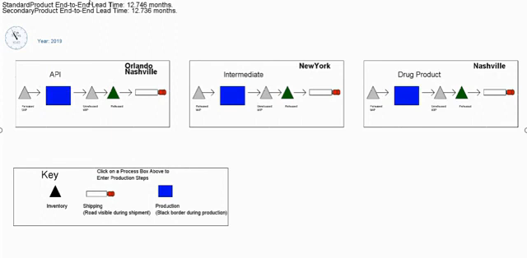
Model Animator (MA)
Supply Chain Model Animation
https://www.youtube.com/watch?v=GVJO2PuJD6w&t=2s

Slide 3
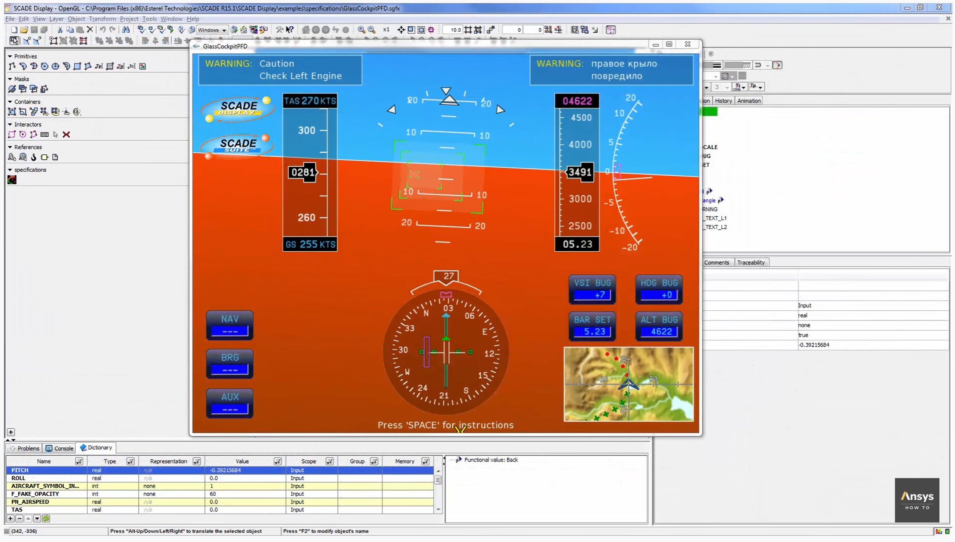



What we don’t address
https://www.youtube.com/watch?v=kaJfTS2WvEA

Slide 4




Roles in MDE
1
Metamodel Level
Domain-Specific Metamodeling Language
Transformation Language
Language
Designer
Conforms to
Conforms to
2
3
Model
Level
Model Definition
Transformation Specification
Modeller
Transformation Expert
Knows
Application
User
MA Designer (new role)

Slide 5


What is a Model Animation ?
Visualization (aka. Rendering)
A rendering transformation assigns one (or more) concrete representation(s) to each abstract syntax element or group of elements in an input model, as long as the meta-model of the concrete syntax is defined explicitly.
Simulation
A simulation transformation defines the operational semantics of a modeling language that updates the modeled system’s states.
Inplace & Endogenous
Animation
Animation is the visualization of a simulation
p1:Pacman
in
C1: CELL
id = 1
MovePacman
1
right
2
1
right
2
in
in
CS
Rendering
MM
Parsing
Simulation
M_{CS}
M
Animation
Simulation
[1] Lúcio, Levi and Amrani, Moussa and Dingel, Juergen and Lambers, Leen and Salay, Rick and Selim, Gehan M. and Syriani, Eugene and Wimmer, Manuel. (2014). Model Transformation Intents and Their Properties. SoSyM 15(3), 647--684

Slide 6
Coordinating Trafos and Animations
Executing one Transformation Unit (TU) triggers the execution of one, or several, Animation Unit(s) (Aus)
Operation 1
Operation 2
Operation 3
Operation 4
Animation 1
Animation 3
Animation 2
Animation 7
Animation 8
Animation 2
Animation 4
Animation 5
Animation 1
Animation 6
dependency
Animation 6
Notes:
What are Min and Mio?
The approach is guided BY TRAFOS: one TU triggers one or several UA, not the other way around
The figure is overcomplicated.
Put four TU steps
The first corresponds to one AU step
The second and fourth correspond to 3 steps
The third correspond to 5

Slide 7
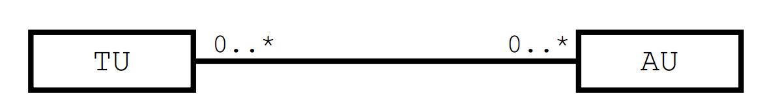
Decoupling TUs and AUs
Tackle the Lack of ﬂexibility in MA specifications
Enable the reuse of AUs
TU₁
AU₁
Dsl1
TU_{i}
AU_{k}
AU₂
Dsl2
TU_{j}
AU₃
Notes:
Remove the image and the “fully unlock…”
EXPLAIN how reuse can be achieved:
1 TU corresponds to several AUs (previous slide)
1 AU may be used for several TUs

Slide 8
Key Challenges
Explicitly define CS for easily expressing MA;
Build an MA language to express AU in a compositional way,
Explicitly relate MA units with their transformation counterparts
Notes:
Change the title to “3 Key Challenges” and just number them

Slide 9
A Simple FSM Metamodel ☺
FSM
1 fsm
name : String [0..1]
alphabet : Integer [1..*]
« enumeration »
Kind
REGULAR
INITIAL
FINAL
1..* states
* transitions
1 token
1 src
Token
1 current
State
Transition
1 word
name : String
1 tgt
trigger : String
Word
Letter
* letters
label : String

Slide 10
Concret Syntax
Notes:
CONCRETE !!!!

Slide 11
Complex Rendering Patterns
Rendering
Visual Representation
Final
State
State
...
Initial
Initial
Regular
Regular State
Final
Initial State
Regular
Final State
Transition
Transition
Notes:
Put the symbol for INITIAL and FINAL states, and write the queries explicitly in each metamodel, with a table for each State kind

Slide 12
Complex Rendering Patterns
Rendering
Visual Representation
Final
State
State
...
Initial
self.kind == INITIAL
Regular
Regular State
FSM
self.kind == FINAL
Initial State
1 fsm
...
1..*
states
« enumeration »
Kind
State
self.kind == REGULAR
Final State
INITIAL
REGULAR
FINAL
kind: Kind
Transition
Transition
Notes:
Put the symbol for INITIAL and FINAL states, and write the queries explicitly in each metamodel, with a table for each State kind

Slide 13
Complex Rendering Patterns
Rendering
Visual Representation
Final
State
State
...
Initial
self == self.fsm.initial
Regular
Regular State
FSM
self == self.fsm.final
Initial State
1 fsm
...
1..*
states
« enumeration »
Kind
State
not (... or ...)
Final State
INITIAL
REGULAR
FINAL
kind: Kind
Transition
Transition
FSM
1 fsm
...
1..*
states
State
1 initial
...
1 final
Notes:
Put the symbol for INITIAL and FINAL states, and write the queries explicitly in each metamodel, with a table for each State kind

Slide 14
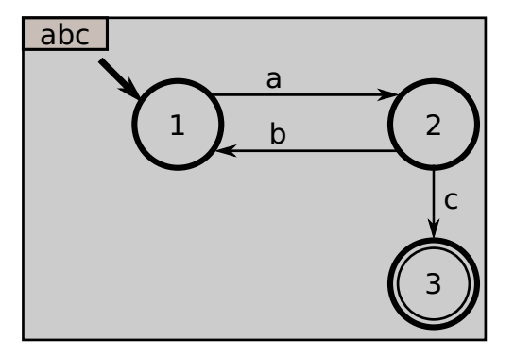
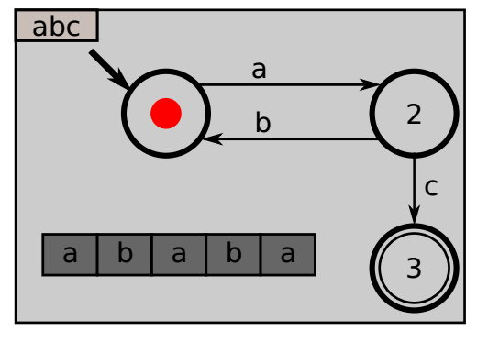
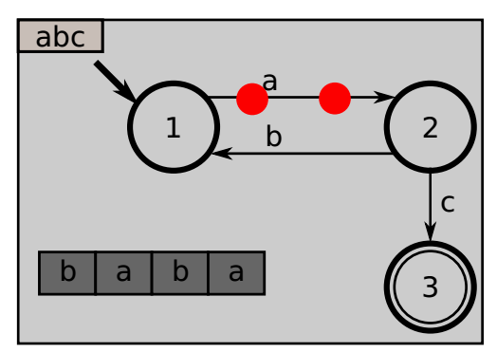
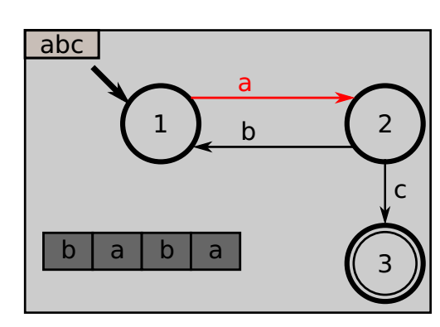
Providing “snapping” capabilities
Alternative representation of MA
e.g. Two categories of Animations
Showing the progression on the word
Showing the FSM’s current state
Variability model animation specification
Sequential
Concurrent
Timed approach
Providing “snapping” capabilities
Notes:
This is not SNAPPING… To be discussed

Slide 15
Integrating “insideness” natively
Example of simultaneous image contrast illusion
e.g. PacMan kills Ghost
Parallel:
① Appear(Pacman)
② Desapear(Ghost)
Sequential:
③ Desapear(Pacman)
④ Appear(Pacman)
Visual
Eﬀects
Sequences
of images chained
Animation
obtained
Illusion
Notes:
Remove Illusionization: it is a very specific term, used in one paper that you read but not the audience, and that does not bring anything.
Similar to previous, this is not what is intended with “insideness”…

Slide 16
Supporting animations natively
Fast Update of Visual Features
Browsing, customize/extend/modify
e.g., the position, size, color
Conjoined/Nested Element Block
Usability Mechanisms
Using the Graphical Elements
Using Visual Language
e.g. Block Oriented Modeling, Causal Modeling
Visual editor workspace
Visual Features
- Position
- size
- color, ..
Graphical Elements
MA Designer
Edit Element
Notes:
I don’t get the figure
I don’t get the examples under “Using Visual Languages”

Slide 17
MA Specification

Slide 18
De-/Re-Constructing MA
Following the approach in [1] for Model Transformation, we need to decouple
Model Animation Effects, from
Model Animation Scheduling
MA Framework
A primitive Combinators
separate
an elements
UA Eﬀects Library
Creation Eﬀects
Basic animation eﬀects
WorkSpace
WorkSpace
Deletion Eﬀects
CTRL 1: Loop
shape
CS components Library
Action Eﬀects
Sequantial
Table
CTRL2: time
Parallel
table
Graphical
Elements
Path Motion
TexBox
combinators outside
Organized and scheduled
C k
Geometric
Combinators m
Element n
delay
Repetitors
//
Embedding
the scheduling inside
the UAs
Complex Animations
[1] Syriani, Eugene and Vangheluwe, Hans (2010). De-/Re-constructing Model Transformation Languages. In Workshop on Graph Transformation and Visual Modeling Techniques.
DOI: http://dx.doi.org/10.14279/tuj.eceasst.29.407
Notes:
Similar to Syriani et al., 2014, we separate
Animation Effects, from
Animation Scheduling
You can orally comment the similarity (Trafo blocks + Scheduling)
The figure does not bring much, and is difficult to read, and requires you to explain it during a long time

Slide 19
MA Effects
Appearing
● ● ●
APP
ZOOMIN
Disappearing
● ● ●
DAPP
ZOOMOUT
Action
● ● ●
Change Color
Change Style
Notes:
Illustrate with simple things, typically on the FSM DSL

Slide 20
UA Scheduling
Theoretical Approaches for UA Scheduling
Embedding the scheduling inside the UAs
Define combinators outside of UAs
A11
A12
A13
B1
B2
||
;
;
B1
B2
A11
;
A12
A13
Notes:
EXAMPLE!!!

Slide 21
Relating
How to relate to the DSL at hand ?
How to synch TU and AU ?

Slide 22


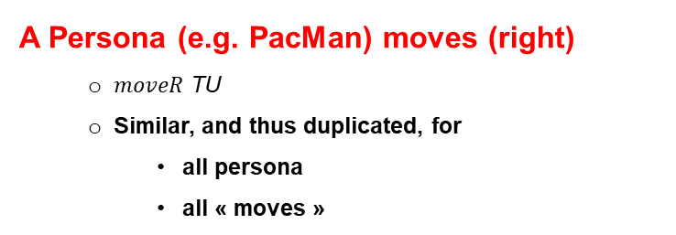
UA Parameterization
A Persona (e.g. PacMan) moves (right)
$moveR$ TU
Similar, and thus duplicated, for
all persona
all « moves »
A Transition is fired, changing the current State
TU fire, defined inside the general transformation accept
SCORE 0
^{Viz}M_{2x2}
abc
tl
right
tr
2
in
left
in
up
up
down
down
3
bl
right
br
a
b
a
b
a
left
in
Define an generic Animation Unit APP-DAPP that
Make a specific element
Disappear from a location, and
Appear into another location

Slide 23

UA Parameterization
BLINK
DAPP
;
APP
period = period
what
on
what
from
what
where
period
tl
period = 1 second
Notes:
Too much things are mixed in this slide…
This should focus on parameters:
Why do we need parameters (typically, illustrate the previous one)?
What problems does it bring to introduce parameters?

Slide 24
UA Parameterization
DAPP
DAPP
what
on
rendering
what
on
what
where
what
where
tl
p1: Pacman
C1: CELL
id = 1
Notes:
Too much things are mixed in this slide…
This should focus on parameters:
Why do we need parameters (typically, illustrate the previous one)?
What problems does it bring to introduce parameters?

Slide 25

MT < > MA Coordination
How to coordinate the MT Engine with AM Engine ?
Locate relevent TUs
Annotating TUs, i.e. @Step annotation
Enable Communication between Engines
Interactive Exploration Services
Transformation Specification
class PacMan { ... @Step def boolean moveR() { if(self.in.right != null){ self.in = self.in. Right}
GeMoC approach for debugging [Erwan B., et al. 2018]
breakpoint
stepInto
stepOver
stepOut
play
examine
steps
examine model state
Notes:
Remove the TU ---- AU figure: this is not its point
Illustrate the idea…
We want to be able to notify the MA engine that a TU is currently executed, so the the MA engine performs the animation.
Two problems here:
How do we locate relevant TUs inside the overall transformation?
What is the communication process between both engines?
Solution: the GeMoC approach for debugging, with
Annotations for TU
Comm protocol based on four notifications (cf. paper… but put them in the slide!)s

Slide 26
Conclusion
TU
0..*
0..*
AU
Key Challenges
Concret
Syntax
Complex Rendering Patterns
Lack of ﬂexibility in MA
Enable the reuse of AUs
MA
Specification
UA
Composer
UA
DSL Tools to perform MA alongside of MT
MA Designer
MT < > MA
Coordination
class PacMan { ... @Step def boolean moveR() {
MT
MA
@Step
Notes:
This should be rewritten completely

Slide 27
Thank you for your attention

